Slide 1

Commercial electrochemical cells
Batteries and fuel cells

Slide 2
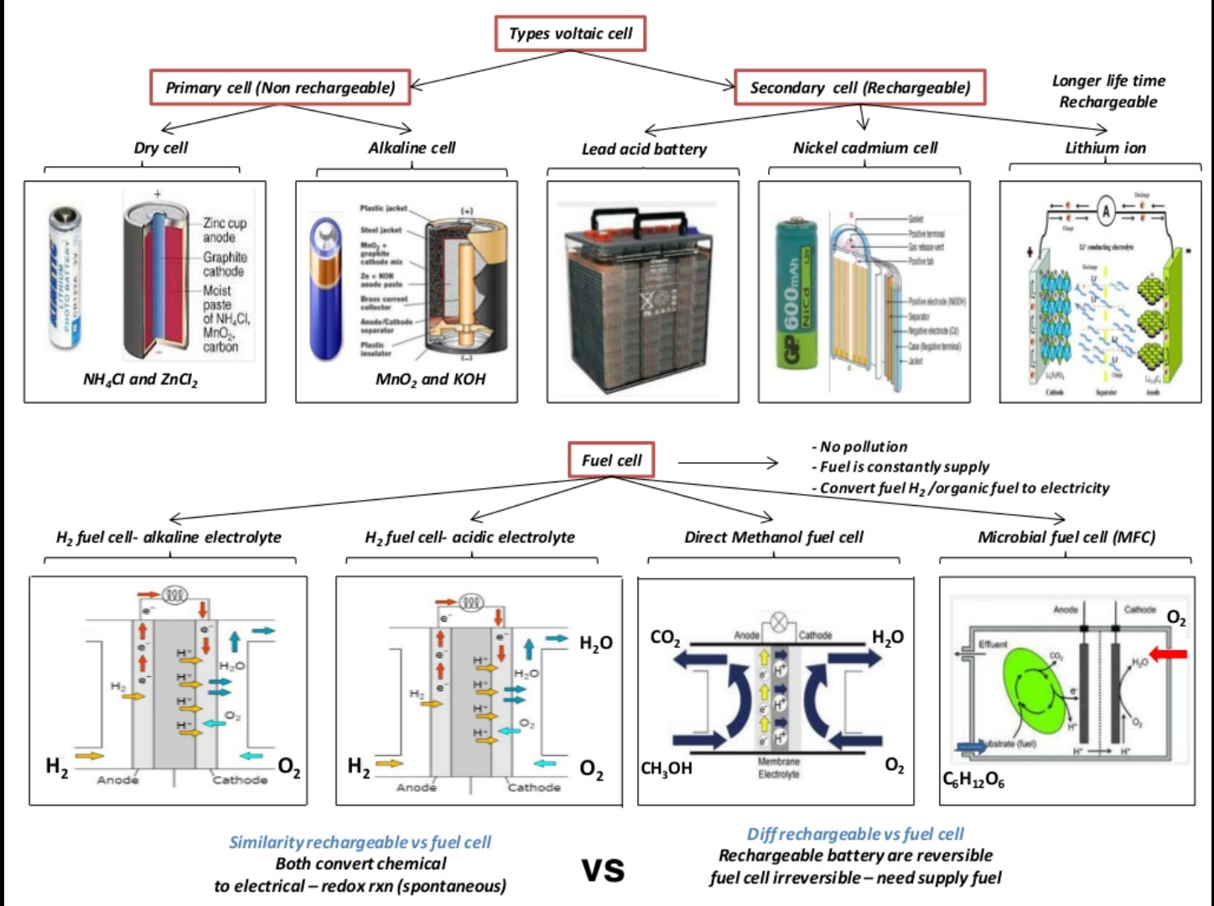

Slide 3
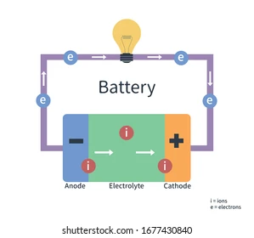
Battery
Convert stored chemical energy into electrical energy
Reaction between chemicals take place
Consisting of electrochemical cells
Contains
Electrodes
Electrolyte

Slide 4
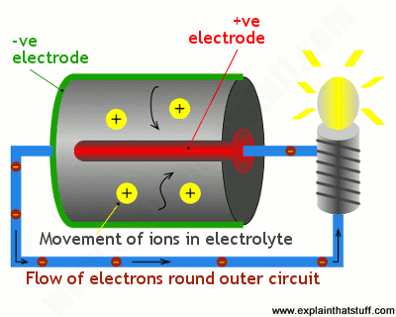
Cathode
Positive terminal
Chemical reduction occurs (gain electrons)
Anode
Negative terminal
Chemical oxidation occurs (lose electrons)
Electrolytes allow:
Separation of ionic transport and electrical transport
Ions to move between electrodes and terminals
Current to flow out of the battery to perform work

Slide 5
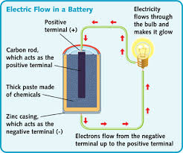
Primary Cell
One use (non-rechargeable/disposable)
Chemical reaction used, can not be reversed
Used when long periods of storage are required
Lower discharge rate than secondary batteries
Use:
smoke detectors, flashlights, remote controls

Slide 6
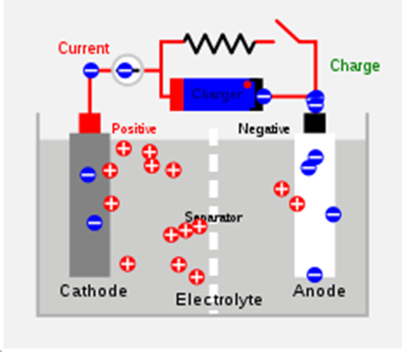
Secondary Cells
Rechargeable batteries
Reaction can be readily reversed
Similar to primary cells except redox reaction can be reversed
Recharging:
Electrodes undergo the opposite process than discharging
Cathode is oxidized and produces electrons
Electrons absorbed by anode

Slide 7
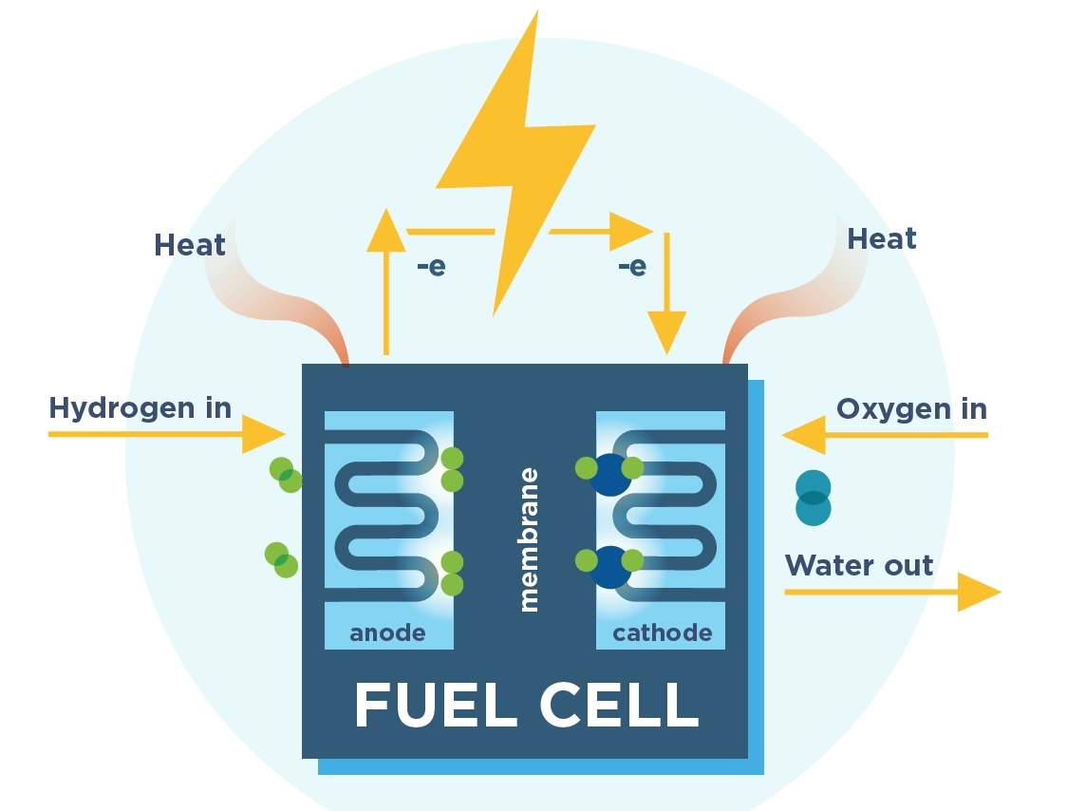
Fuel Cells
fuel cells differ from primary cells and secondary cells in that they do not store the oxidising or reducing agent
instead, these reactants are constantly fed into the cell to produce electricity

Slide 8
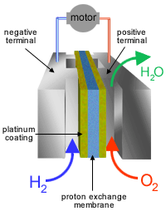
Fuel Cells
The most common fuel cell is based on the reaction between hydrogen and oxygen to form water
Chemical by products are expelled from the cell as it operates
The electrodes are porous, compressed carbon containing a suitable catalyst
The electrolyte may be either hydrochloric acid or potassium hydroxide

Slide 9

Complete the worksheet on different examples of commercial cells then continue working on essential chemistry set 11 and 12

